Slide 1
Encoder
An encoder is a combinational logic circuit that essentially performs a “reverse” of decoder functions.
An encoder accepts an active level on one of its inputs, representing digit, such as a decimal or octal digits, and converts it to a coded output such as BCD or binary.
Encoders can also be devised to encode various symbols and alphabetic characters.
The process of converting from familiar symbols or numbers to a coded format is called encoding.

Slide 2
Most decoders accept an input code and produce a HIGH
at one and only one output line. In otherworlds , a decoder identifies, recognizes, or detects a particular code. The opposite of this decoding process is called encoding and is performed by a logic circuit called an encoder.
An encoder has a number of input lines, only one of which input is activated at a given time and produces an N-bit output code,depending on which input is activated.

Slide 3
Encoders
Decimal-to-BCD encoder
8-line-to-3-line encoder

Slide 4
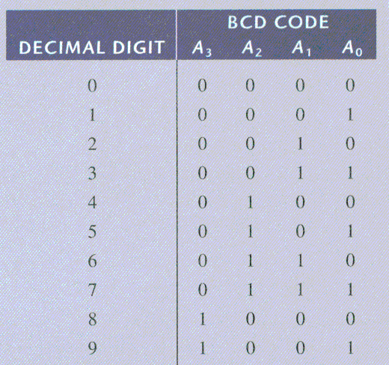
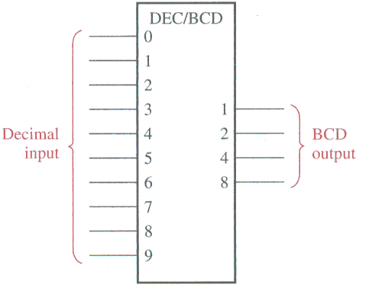
Encoders
Decimal-to-BCD encoder

Slide 5
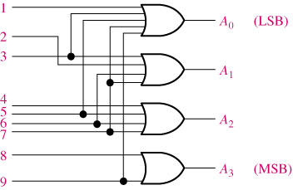

Slide 6
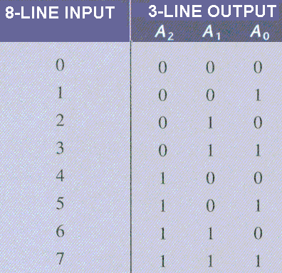
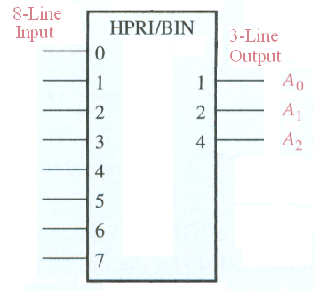
Encoders
8-line-to-3-line encoder

